Slide 1

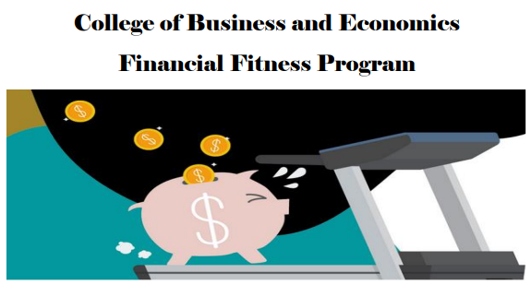

Income Tax Basics

Slide 2

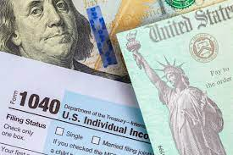
Income Tax Basics
“Taxes are what we pay for a civilized society”
U.S. Supreme Court Justice Oliver Wendell Holmes, Jr.
Taxes are pervasive
  Income tax Sales Tax Gas Tax Alcohol Tax & More
  (highest in the nation!) (highest in the nation!) ($1.18/gallon!!)
Cal State LA / Department of Accounting

Slide 3
Income Tax Basics
How does it work?
Income $24,000
Less: Standard Deduction ( 12,550)
Taxable Income $11,450
Tax Liability $ 1,178
Payments You Made 1,500
Tax Refund $ 322
Cal State LA / Department of Accounting

Slide 4

Income Tax Basics
How do you feel about your income taxes?
But…. WHY?
Income taxes are not that difficult to prepare for most people – What you need to know:
What amounts are taxable when received?
Do I need to keep records of interest paid, charitable contributions, school tuition & books, etc.?
How can I prepare the tax forms? Where do I get them? Free software?
Cal State LA / Department of Accounting

Slide 5
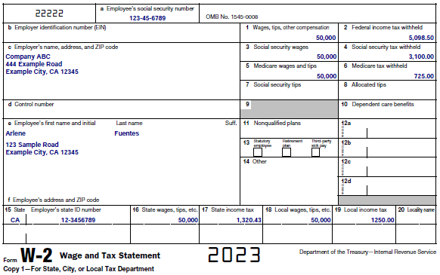
Income Tax Basics
What amounts are taxable when received?
Wages – Form W-2
Cal State LA / Department of Accounting

Slide 6
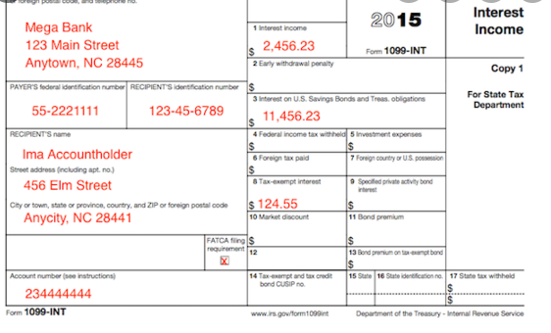
Income Tax Basics
What amounts are taxable when received?
Interest/Dividend Income – Form 1099 INT or DIV
Cal State LA / Department of Accounting

Slide 7
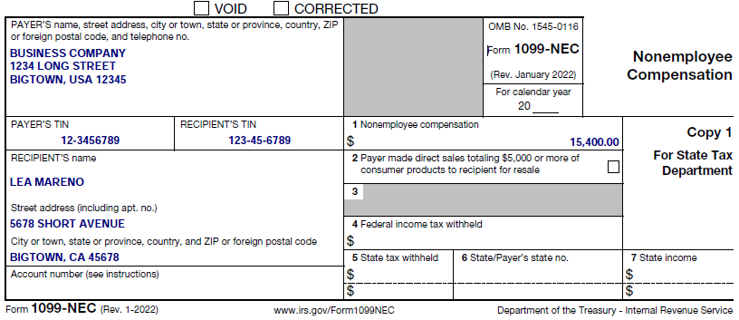
Income Tax Basics
What amounts are taxable when received?
Self Employment Income – Form 1099 NEC
  Uber/Lift Driver
  Delivery Services
  Expenses
Cal State LA / Department of Accounting

Slide 8
Income Tax Basics
What amounts are taxable when received?
Cash Income with No Tax Form Received
  Taxable! (no $600 floor)
Not Taxable
  Gifts received
  Inheritances
  Amounts borrowed (Student Loans)
  Scholarships (used for qualifying education expense)
  Repayment received for loans made (Loan to Friend)
Cal State LA / Department of Accounting

Slide 9
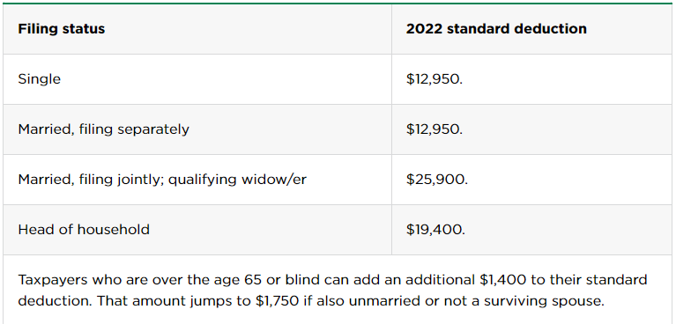
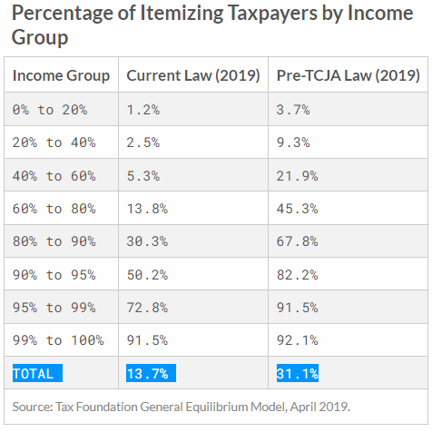
Income Tax Basics
Do I need to keep records of interest paid, charitable contributions made, or school books & equipment purchased?
Standard Deduction vs. Itemized Deduction
The 2017 Tax Act doubled the amount of the standard deduction which resulted in more than 85% of taxpayers not itemizing!
True Tax Simplification!!
Cal State LA / Department of Accounting

Slide 10
Income Tax Basics
Do I need to keep records of interest paid, charitable contributions made, or school books & equipment purchased?
Interest Paid – generally, only mortgage interest is deductible (if you itemize) so no need to keep records for credit card interest, auto loan interest, etc.
Charitable Contributions – only keep if you will itemize deductions (prior year Covid relief deduction of up to $300 (single) or $600 (married) has ended)
School Books, Equipment, and Supplies – Yes! Education credits are available for you (even if you claim the standard deduction)
Cal State LA / Department of Accounting

Slide 11

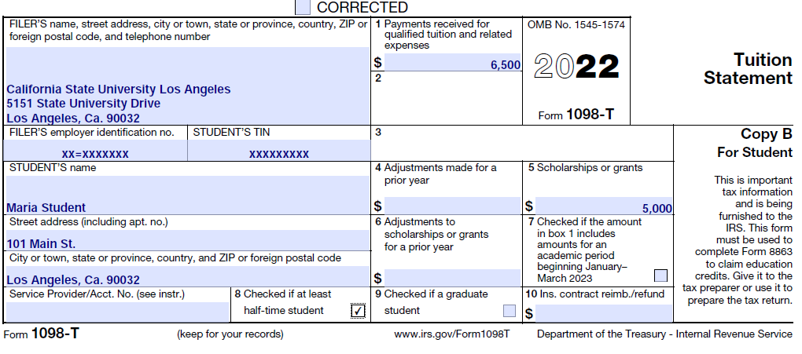
Income Tax Basics
American Opportunity Credit:
Pursuing a degree or credential
Enrolled at least ½ time
In your first four years of higher educ.
Cannot have claimed the AOC for more than 4 years
Up to $2,500 credit!
Plus: Out of pocket amounts paid for books, supplies, etc.
Cal State LA / Department of Accounting

Slide 12
Income Tax Basics
How is your income tax return being prepared?
Friend or family prepares it for me
Paid tax preparer
I do it myself!
Take charge of this!
Friend or family prepares it for me – do it with them a few times, then do it yourself
Paid tax preparer – check out ways to do it yourself
I do it myself! – good for you!
Cal State LA / Department of Accounting

Slide 13

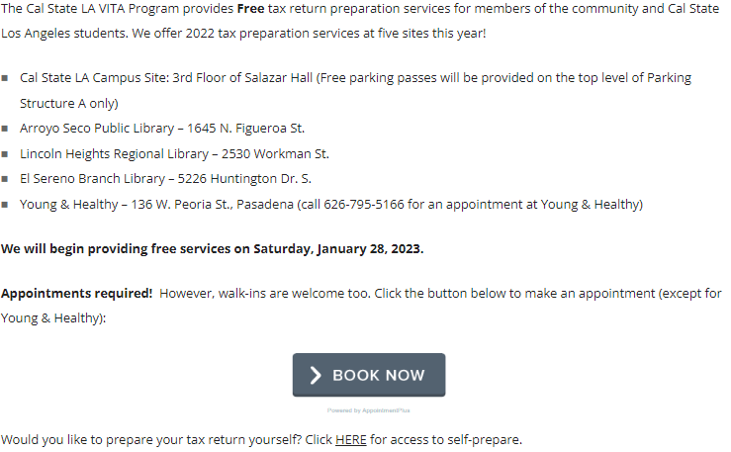
Income Tax Basics
Free Tax Preparation at Cal State Los Angeles!
https://www.calstatela.edu/programs/vita
Consider becoming a VITA volunteer!
Cal State LA / Department of Accounting

Slide 14
Income Tax Basics
Questions??
Prof. John Cooper
jcooper3@calstatela.edu
Cal State LA / Department of Accounting

