Slide 1
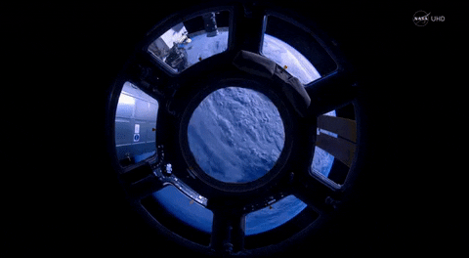

Slide 2
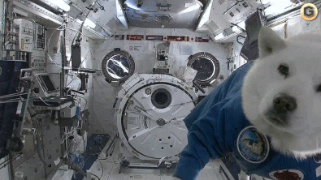

Slide 5
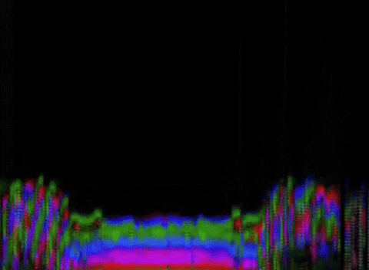

Slide 8
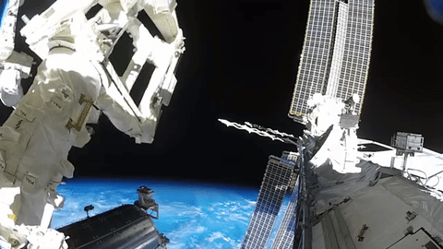
Problem
Strange behaviors or anomalies occur on satellites

Slide 9
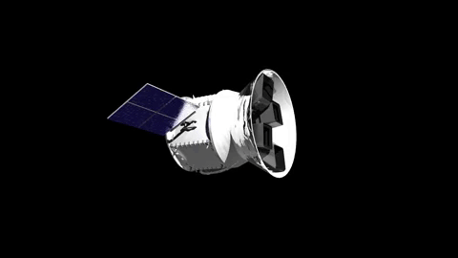
Solution
Inject and detect anomalous simulations

Slide 10
5 Anomalies

Slide 11
1. Denial of Service 2. Runaway Task 3. Memory Leak 4. Single Bit Error 5. Invalid Command Sequence

Slide 12
1. Denial of Service 2. Runaway Task 3. Memory Leak 4. Single Bit Error 5. Invalid Command Sequence

Slide 13
1. Denial of Service 2. Runaway Task 3. Memory Leak 4. Single Bit Error 5. Invalid Command Sequence

Slide 14
1. Denial of Service 2. Runaway Task 3. Memory Leak 4. Single Bit Error 5. Invalid Command Sequence

Slide 15
1. Denial of Service 2. Runaway Task 3. Memory Leak 4. Single Bit Error 5. Invalid Command Sequence

Slide 16
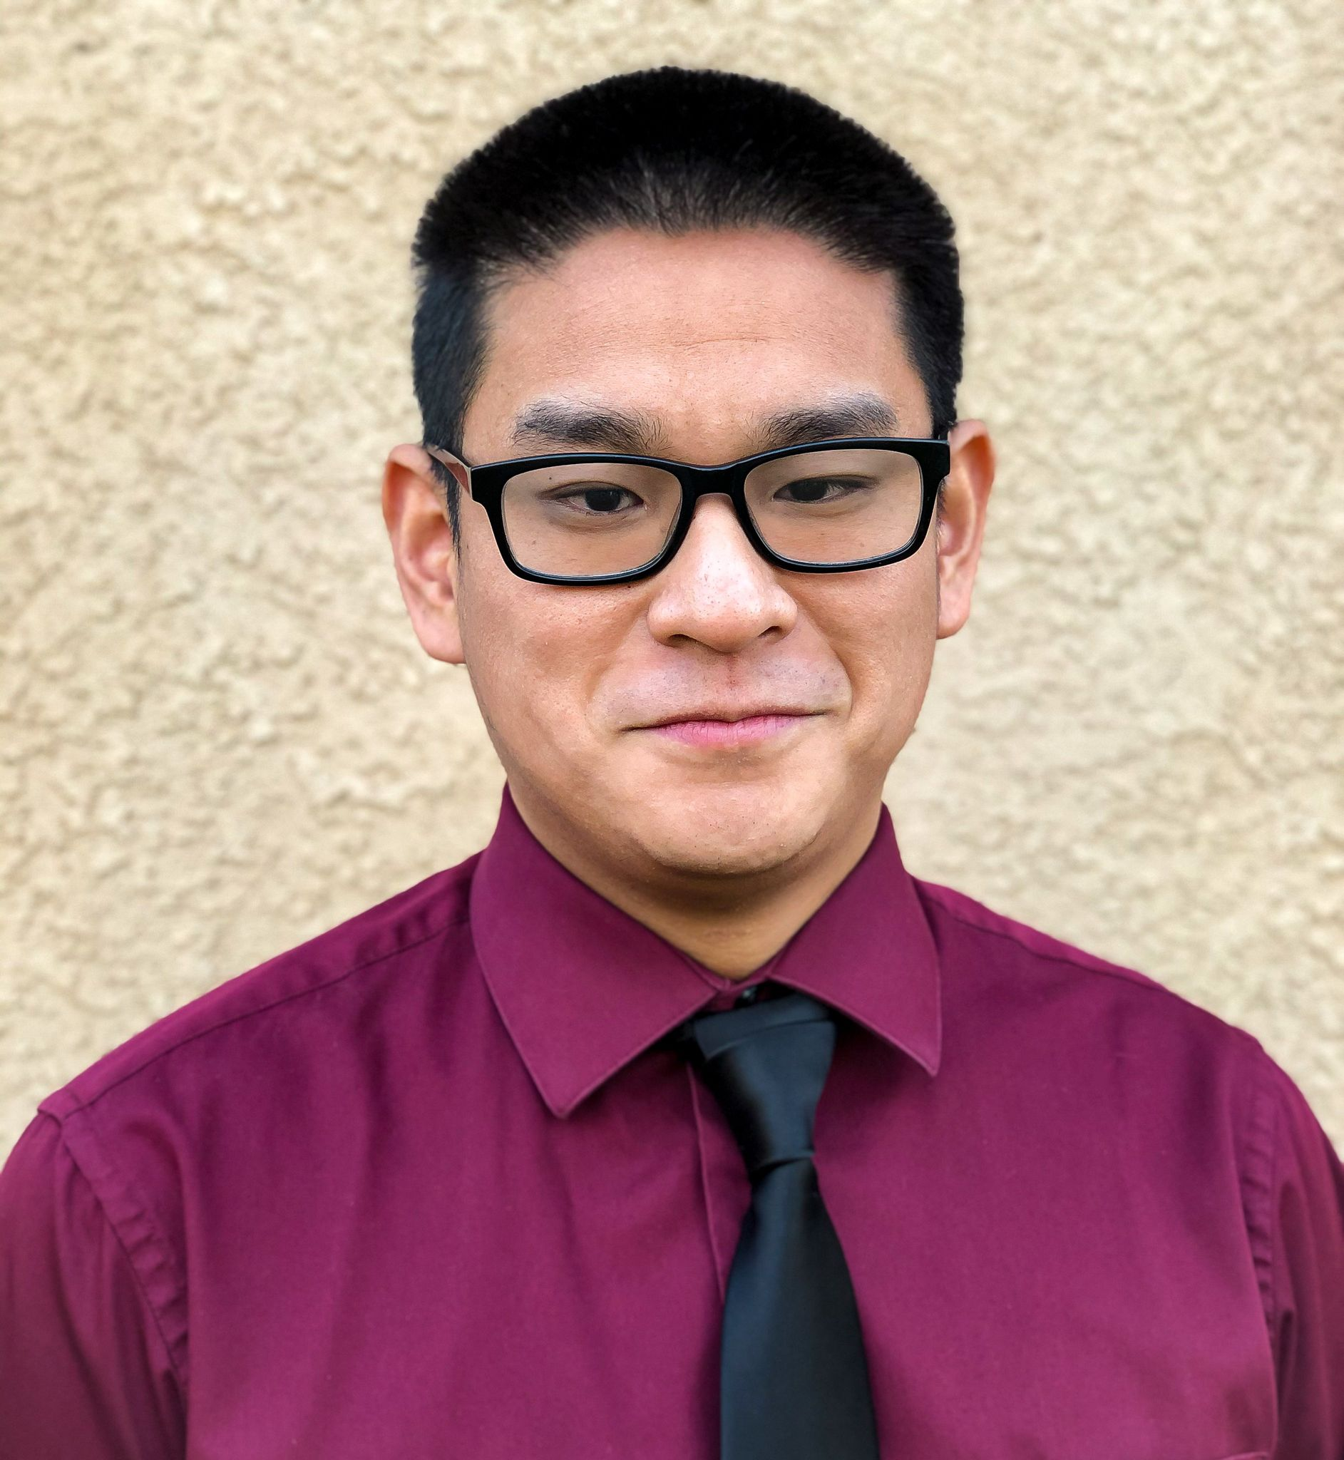
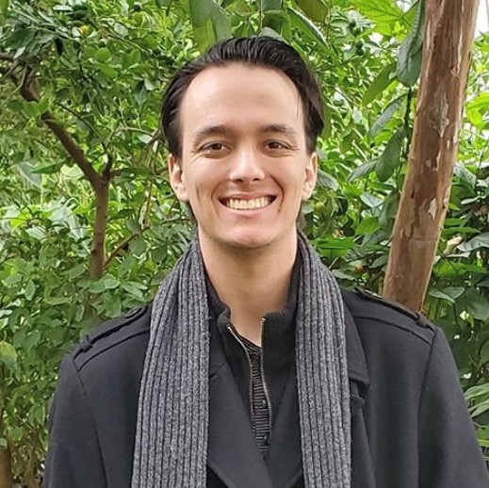
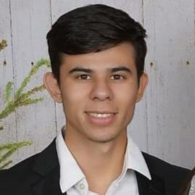
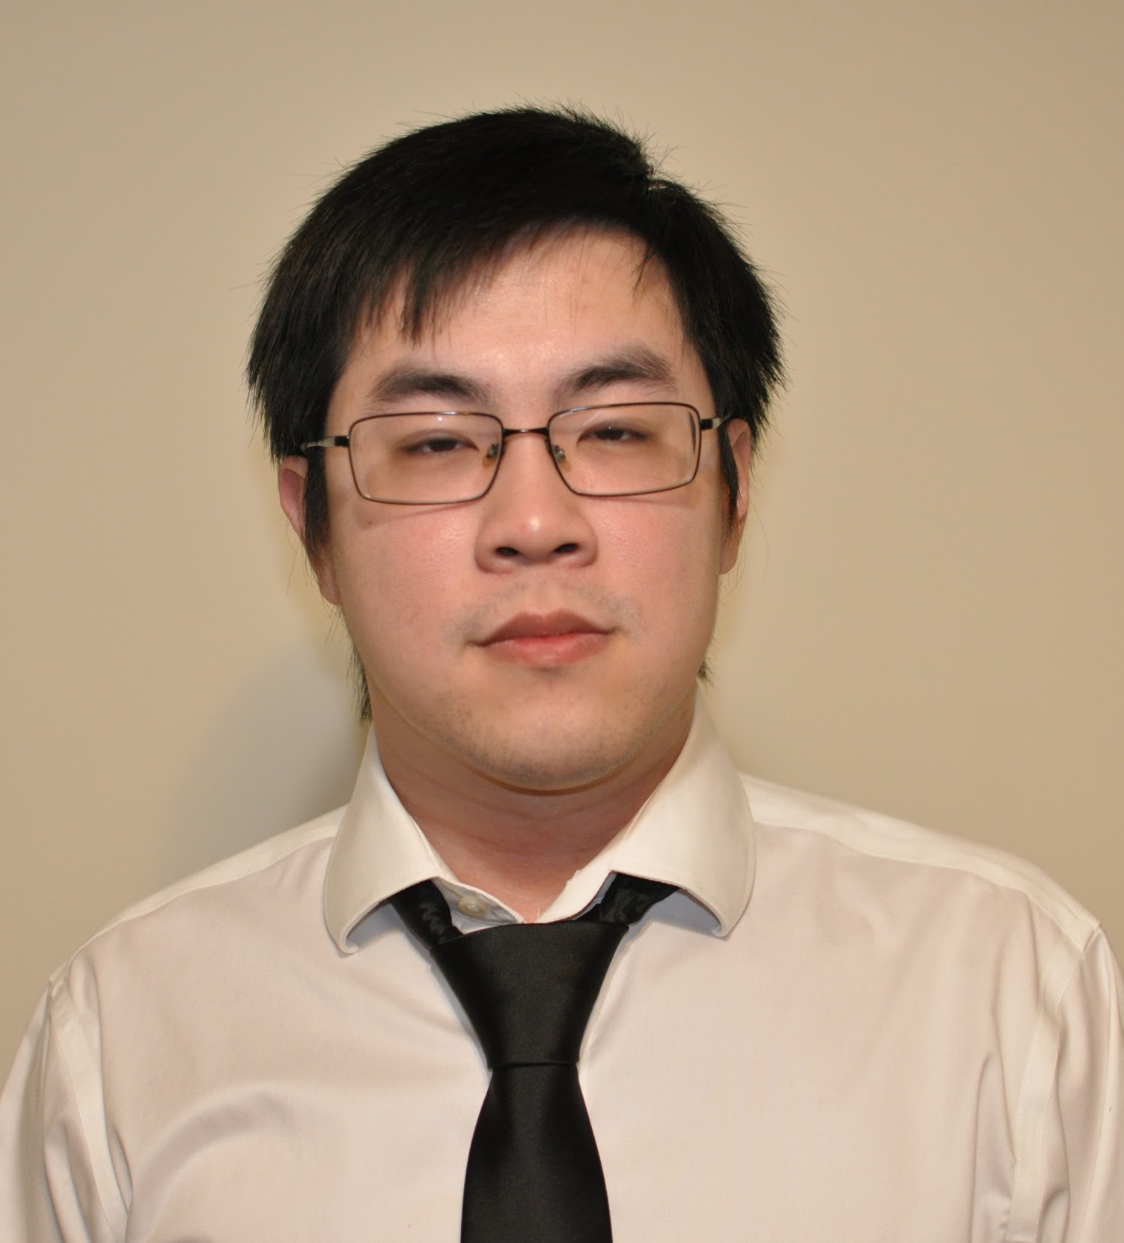
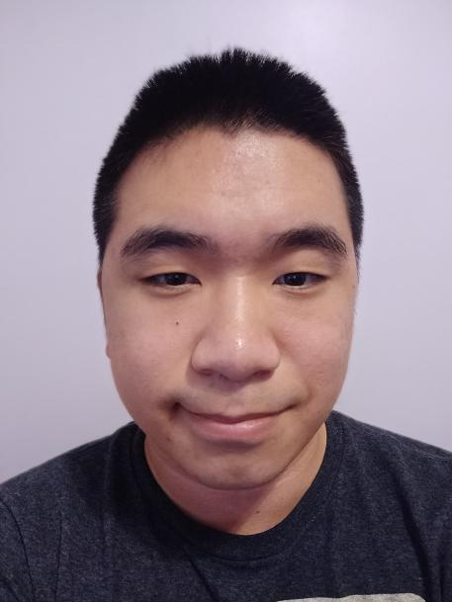
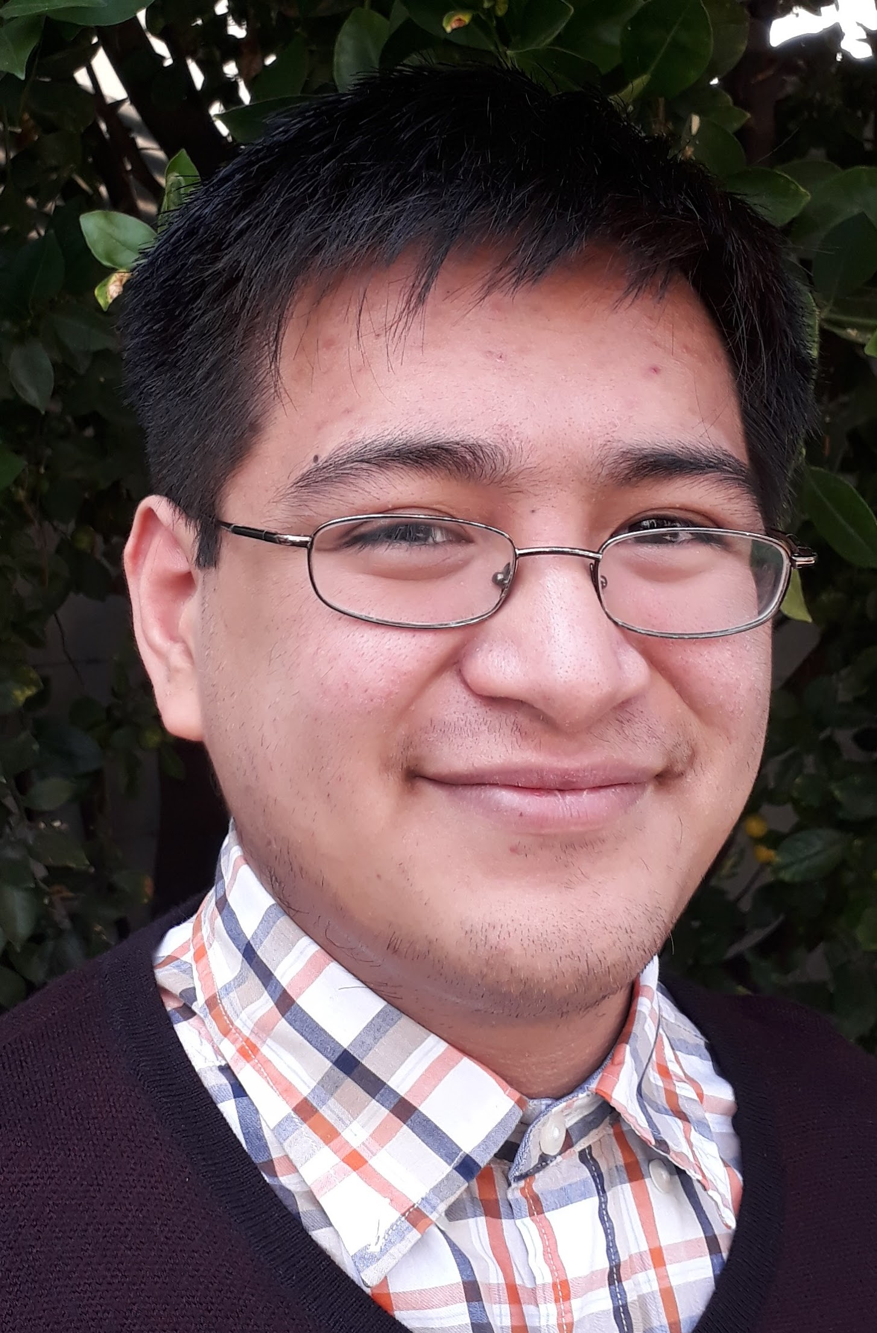
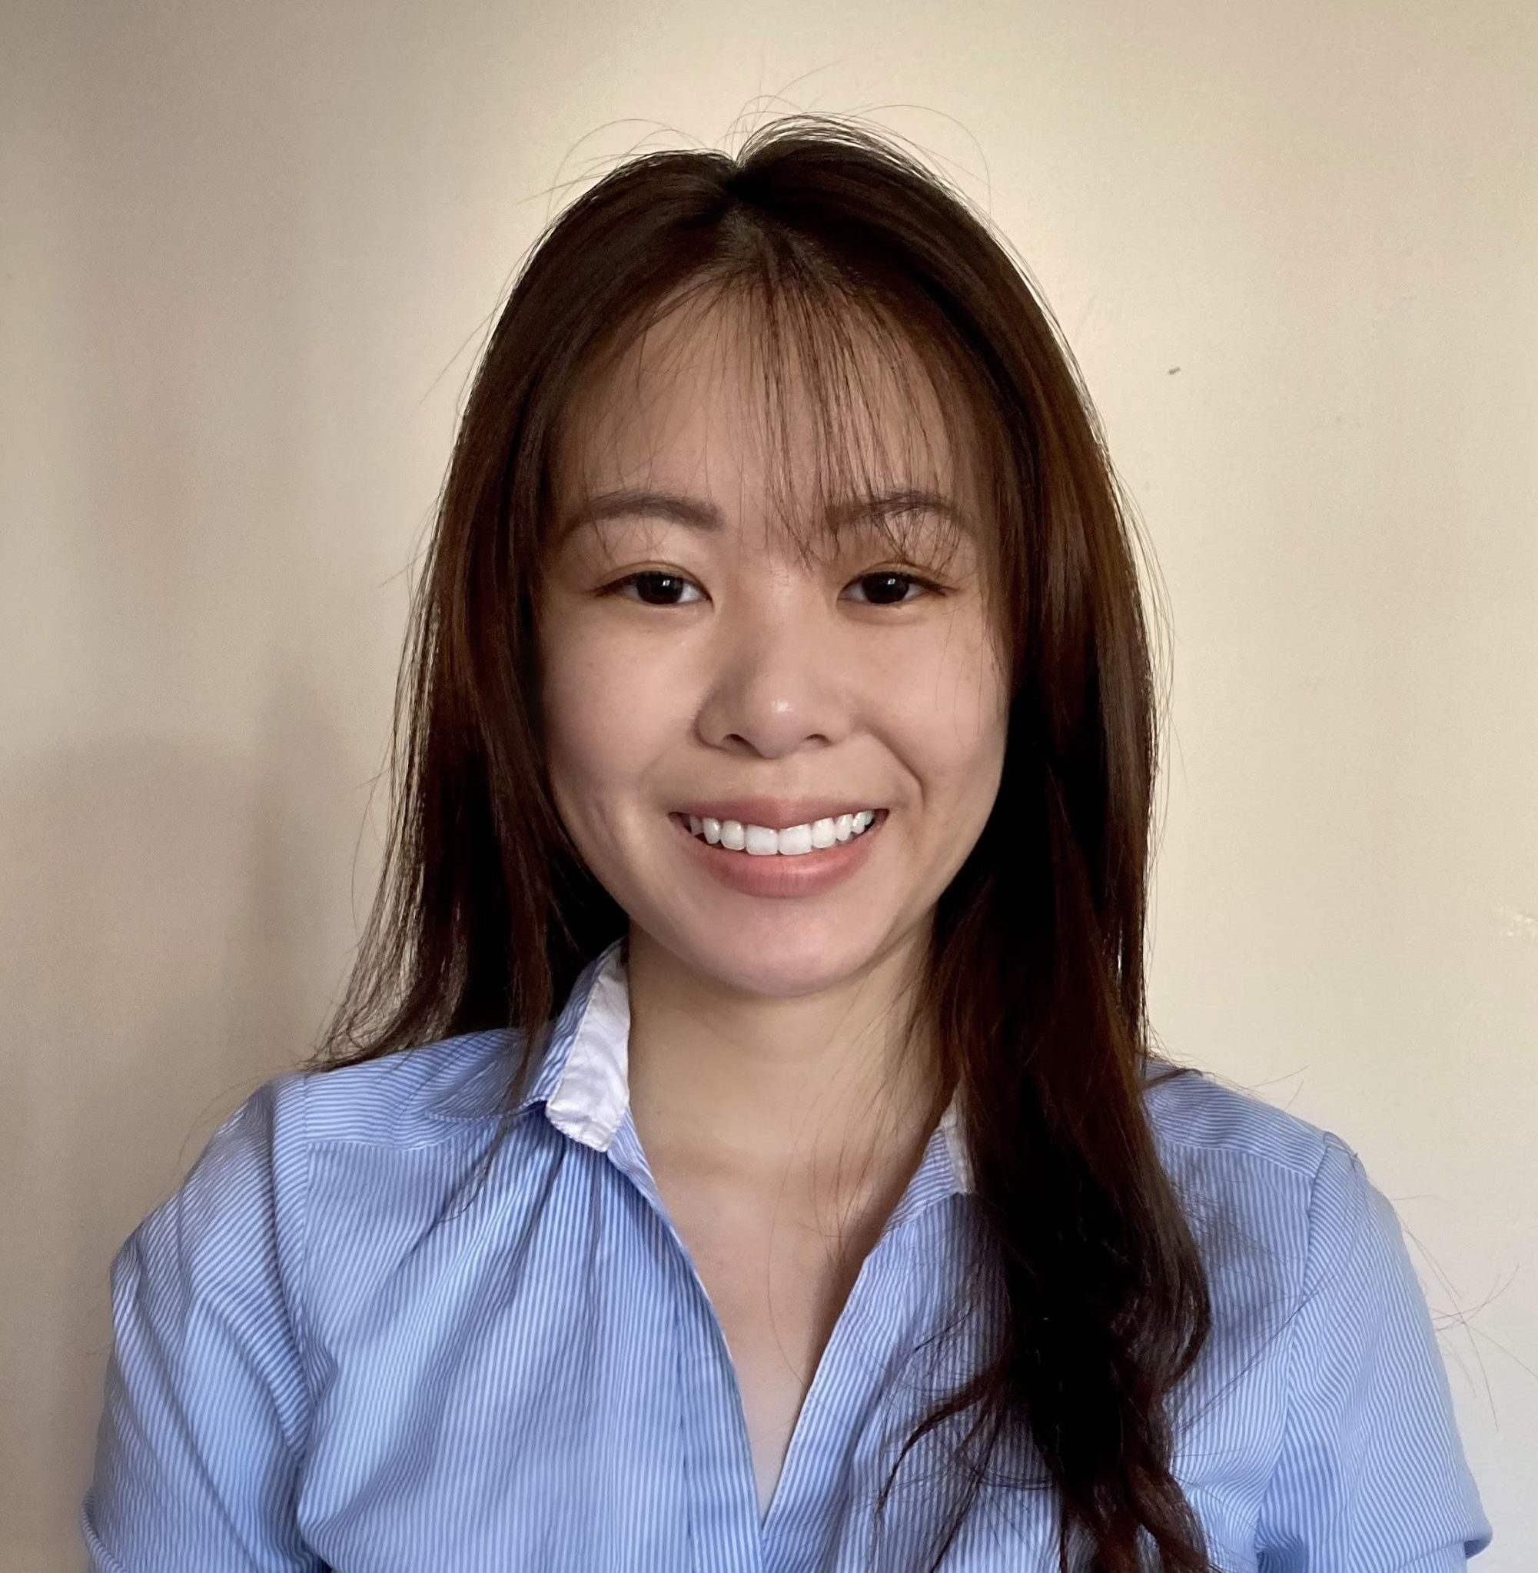
THE TEAM
Joshua Tran
Samantha Simpson
Matthew Gilligan
Nicholas Torres
Alex Huang
Aaron Tong
Vivian Sau
Jerome Pineda
Alex Lopez

Slide 17
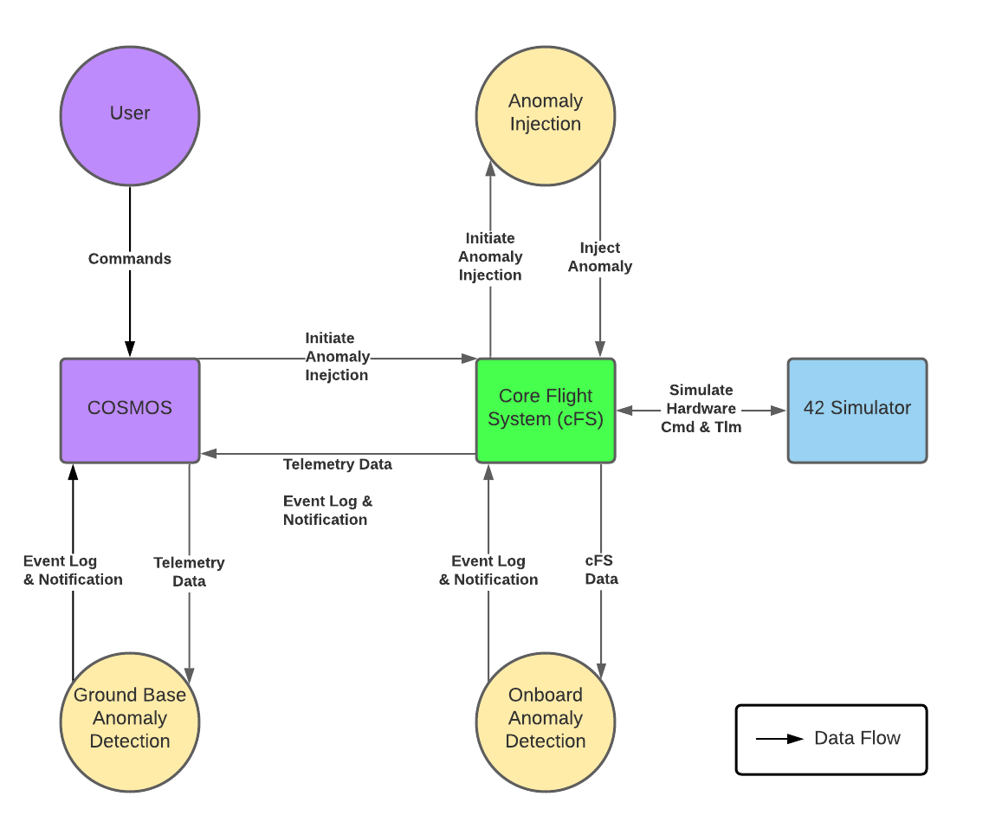
System Architecture

Slide 18
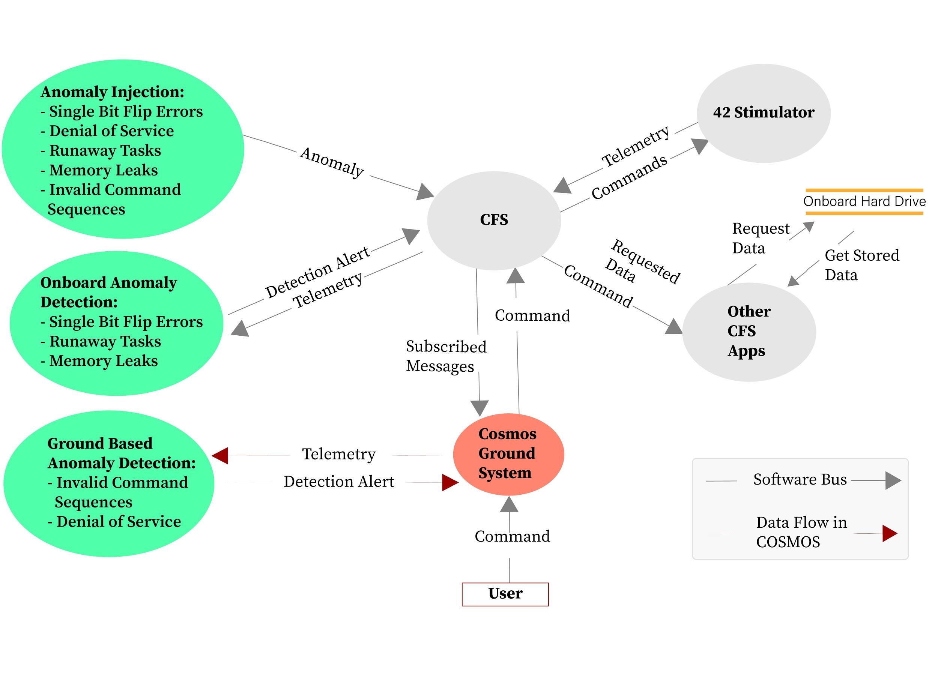
System Architecture

Slide 19
1. Denial of Service

Slide 20
1. Denial of Service
DDOS
DDOS
DDOS
DDOS

Slide 21
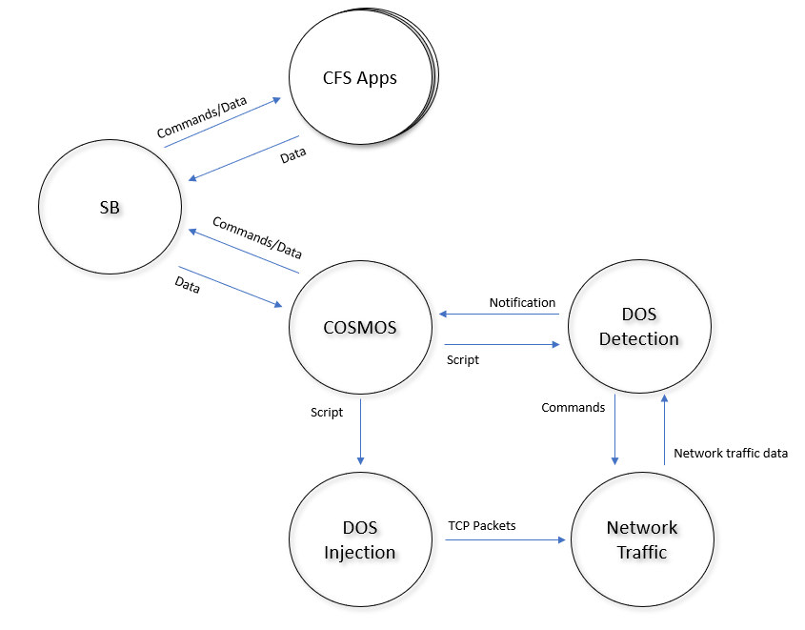
1. Denial of Service
Injection

Slide 22
2. Runaway Task

Slide 23
2. Runaway Task
Vulnerabilities
Environment

Slide 24
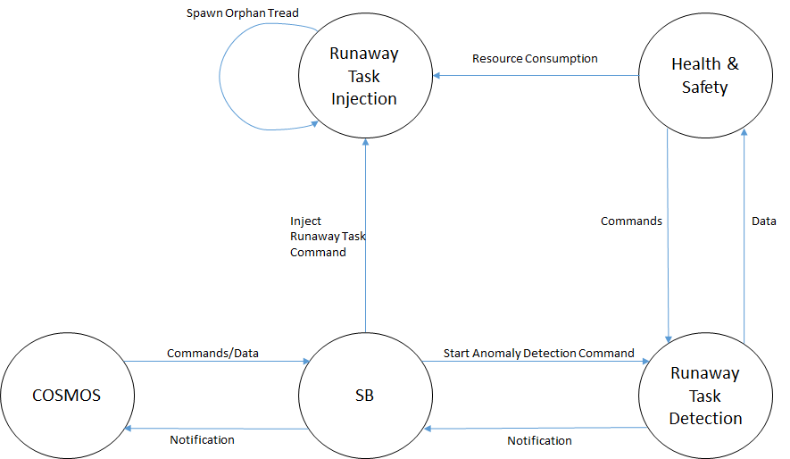
2. Runaway Task

Slide 25
3. Memory Leak

Slide 26
Loading . . .

Slide 27
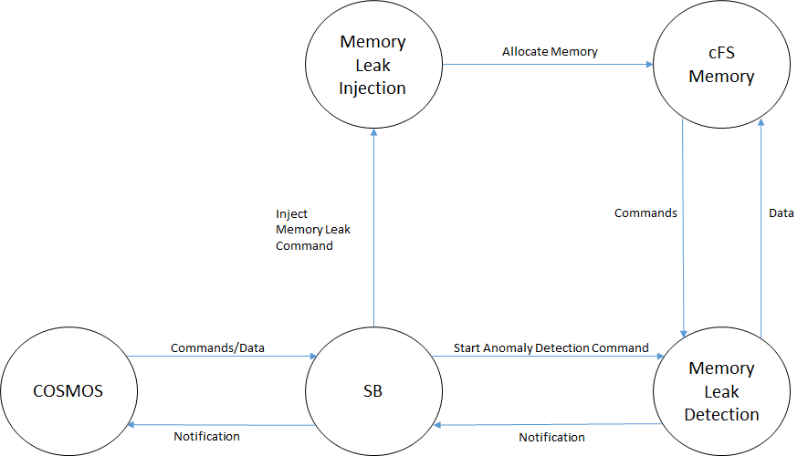
3. Memory Leak

Slide 28
4. Single Bit Error
1 0 1 0 1 0 1 0

Slide 29
4. Single Bit Error
1 0 1 0 1 0 1 0

Slide 30
4. Single Bit Error
1 0 1 0 1 0 1 0
1 0 0 0 1 0 1 0

Slide 31
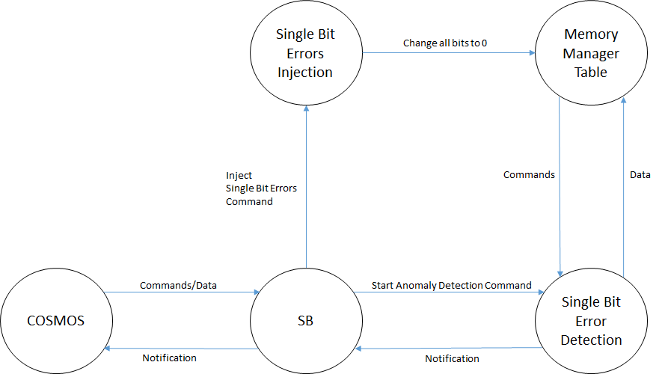
4. Single Bit Error

Slide 32
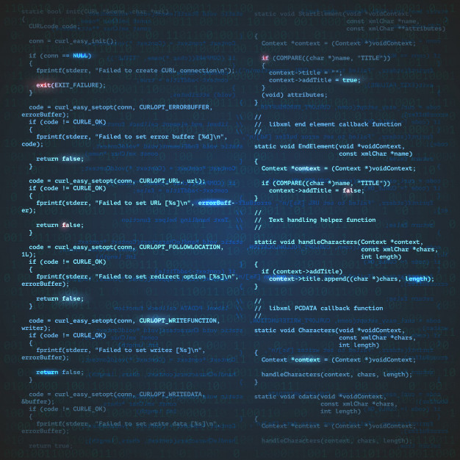
5. Invalid Command Sequence

Slide 33
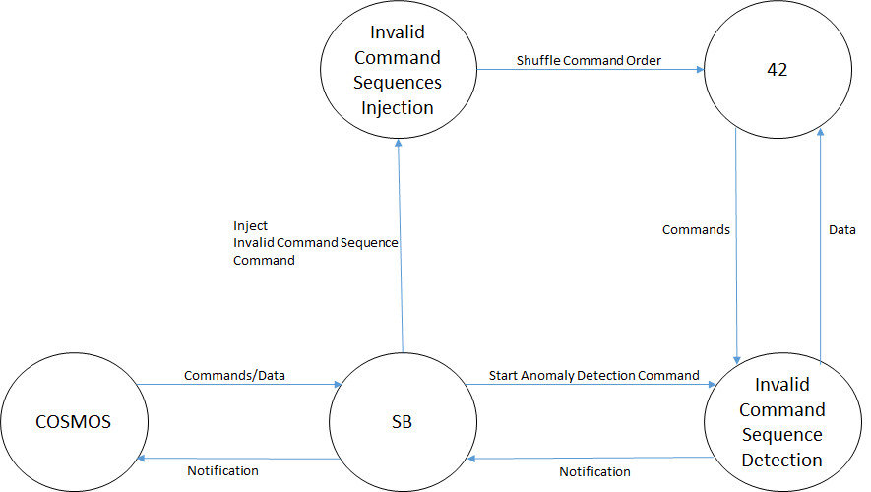
5. Invalid Command Sequence

Slide 34
Final Stretch
1. Denial of Service 2. Runaway Task 3. Memory Leak 4. Single Bit Error 5. Invalid Command Sequence

Slide 37
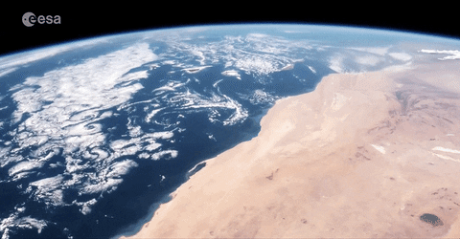
Final Stretch

Slide 38
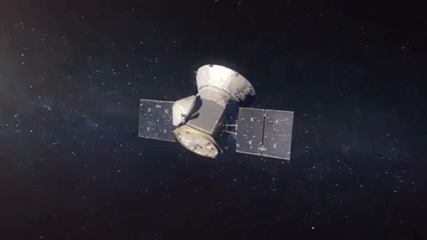

Slide 40
Special Persons
Aerospace Liaisons
Rick Johnson,
Denny Ly,
Karina Martinez,
Pablo Settecase
Faculty Advisor
Russ Abbott
OSK Developer
David McComas

Slide 41
Thank You For Watching
Joshua Tran josh.dtran@gmail.com
Samantha Simpson simpsonnsamantha@yahoo.com
Matthew Gilligan
matthew.gilligan98@gmail.com
Nicholas Torres torresnick272@gmail.com
Alex Huang interdimensionalwaterbear@gmail.com
Aaron Tong pbjt2.edu@gmail.com
Vivian Sau sauvivian@gmail.com
Alex Lopez alalexalex152@gmail.com
Jerome Pineda jeromepineda79@gmail.com

